Slide 1

REMOTELY ACTIVATED CONTROL AND DEMAND RESPONSE OF AGGREGATED ELECTRIC VEHICLES
Michael McDonald (s1425486)
Electrical and Mechanical Engineering BEng (hons) 1 February 2017

Slide 2
“This project will focus on the technical and economical feasibility of providing grid services through demand response on vehicles that are connected to a uni-directional charge point with no smart capabilities”

Slide 3
PROJECT SCOPE OBJECTIVES
Literature Review into current and future demand response options
Frequency response
Voltage response
Technical feasibility of using delayed charging of a BEV/PHEV fleet for aggregated demand response
Load increasing/reducing
Global demand response (frequency)
Localised demand response (voltage)
Economical feasibility of using delayed charging of a BEV/PHEV fleet for aggregated demand response
Statistical risk of compliance
Cost of having diesel generator backup
Technology feasibility and implementation strategy
Sample algorithm and machine learning model

Slide 4
SYSTEM LOGIC CHARGE CONTROL WITHOUT DSR
EV Plugged in
0
1
CHARGING
SOC < 100%
NOT CHARGING
1
0

Slide 5
SYSTEM LOGIC CHARGE CONTROL WITH DSR
EV Plugged in
0
1
CHARGING
SOC < 100%
NOT CHARGING
0
1
Charging needed by user
1
0
Needed for DSR
0
1

Slide 6
POTENTIAL OF SERVICE NEED FOR DEMAND RESPONSE
By 2020 the National Grid wants DSR to provide 30-50% of capacity in the electricity-balancing market, as opposed to just 4% today. ^{[1]}
If just 5% of peak demand is met by demand side response solutions, collectively we could benefit consumers by £790 million. ^{[2]}
More than 750,000 Nest Thermostats worked together to reduce energy demand by 700 MW during the eclipse. ^{[3]}

Slide 7
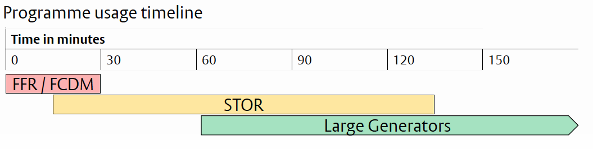
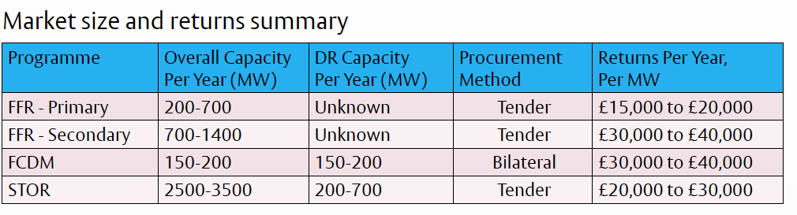
REVIEW OF FINDINGS DEMAND RESPONSE MECHANISMS
Notes:
Referenced: Overview of the UK Demand Response (Mitchell Curtis 2015)

Slide 8
REVIEW OF FINDINGS FREQUENCY RESPONSE SERVICES
Technology | Minimum size* | Notice Period | Duration | Regularity** | Value*** | Contract
Static Firm Frequency Response (FFR) | 10MW | 30 sec | Max 30 min Typically 5 min | 10–30 | ££ | Monthly electronic tender
Dynamic FFR | 10MW | 2 sec | Max 30 min Typically 3-4 min | Daily | £££ | Monthly electronic tender
FFR Bridging | <10MW | 30 sec | 30 min | 10–30 | ££ | Bilateral contract of 12–24 months to transition in to the FFR market (either Static or Dynamic).
Frequency Control by Demand Management (FCDM) | 3 MW | 2 sec | 30 min | 10 | ££ | Bilateral contracts for 1–2 yrs. Week ahead notification of daily load able to shed
Enhanced Response (EFR) | 1-5MW | 1 sec dynamic | Max 15 min Typically 3–4 min |  | £££ | New product – trial tender
Notes:
* to contract directly with National Grid (smaller loads via demand side providers)
** Average number of times called on per year, based on recent data. Source: National Grid
*** Relative value to participant
£ the greater the number of ‘£’ signs indicates a greater value to the demand side participant
Referenced : Demand Side Flexibility Annual Report 2016 (National Grid 2017)

Slide 9
REVIEW OF FINDINGS RESERVE SERVICES
Technology | Minimum size | Notice Period | Duration | Regularity | Value | Contract
Short Term Operating Reserve (STOR) | 3MW | 20 min | 2–4 hrs Typically | Able to deliver 3x per week | £ | 3 tenders p.a. ‘Committed’ or ‘Flexible’ service
STOR Runway | <3MW | 20 min | 2–4 hrs Typically | Able to deliver 3x per week | £ | Bilateral contract
Fast Reserve | 50MW | 2 min, reaching 50 MW in 4 min | 15 min |  | £ | Monthly tender
Demand Turn Up | 1MW | 10 min, sometimes requested day-ahead | Min 30 min |  | £ | New product – trial tender
Notes:
£ the greater the number of ‘£’ signs indicates a greater value to the demand side participant
Referenced : Demand Side Flexibility Annual Report 2016 (National Grid 2017)

Slide 10
REVIEW OF FINDINGS RIVAL TECHNOLOGIES
Technology | Demand shift capability | Supply capability | Running cost | Installation cost | Consumer irritation
Dedicated demand response generators |  |  | £££ | ££££
Bi-directional smart EV charge points |  |  |  | £££
Uni-directional smart EV charge points |  |  |  | ££
Aggregated fast-charge facilities |  |  | £ | £££
Remotely controlled demand response |  |  |  | £

Slide 11
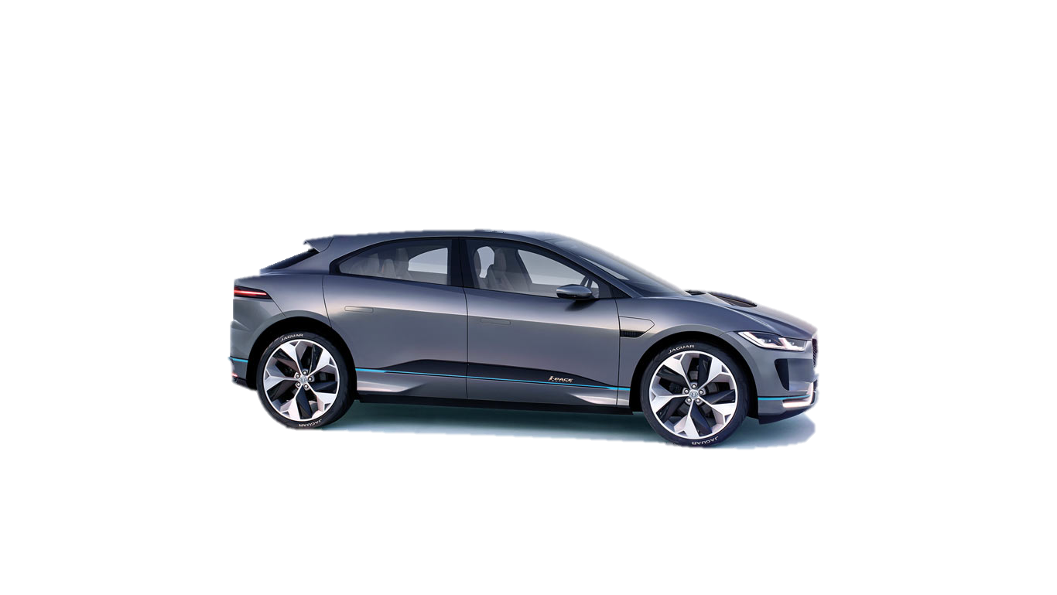
VEHICLE DEFINITIONS BEV and PHEV
Vehicle | Class | Battery Capacity | Max Charge Rate | Time to charge at home | Range on battery
Jaguar I-Pace | Battery Electric Vehicle (BEV) | ~100 kWh | 150kW | 15 Hours (7kW) | 310 miles
Audi Q7 e-tron | Plug in Hybrid Electric Vehicle (PHEV) | 17.3 kWh | 7kW | 2.5 Hours (7kW) | 34 miles
Audi Q7 e-tron
Jaguar I-Pace
Notes:
The target vehicles chosen are the Jaguar I-Pace battery electric vehicles and the Audi Q7 e-tron plug in hybrid vehicle. These were chosen as the high range electric vehicles will have the highest demand response capabilities per device with the plug in hybrids offering the least disturbance to drivers and the two being in a comparable vehicle bracket
Image credit: http://ksassets.timeincuk.net/wp/uploads/sites/54/2017/03/jaguar-ipace-4-1.jpg/
https://www.audi.co.uk/audi-innovation/e-tron.html
Information sources:
I-Pace: Abhishek Sampat, JLR
e-tron: https://www.audi.co.uk/audi-innovation/e-tron.html

Slide 12
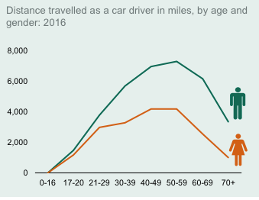
DRIVER PROFILES POSSIBLE DATA FOR ANALYSIS
National Travel Survey 2016
My Electric Avenue project
Google location (subject to collection)
JLR – no longer applicable
Notes:
https://www.gov.uk/government/uploads/system/uploads/attachment_data/file/633077/national-travel-survey-2016.pdf

Slide 13
DRIVER PROFILES USE CASES
Use Case | Age | Gender | Works at home | Daily commute distance (miles) | Time parked* | Time to charge**
A | 31-39 | Male | yes | 16 | ? | 1.4
B | 31-39 | Male | no |  | ?
C | 31-39 | Female | yes | 9 | ? | 0.8
D | 31-39 | Female | no |  | ?
E | 50-59 | Male | yes | 19 | ? | 1.7
F | 50-59 | Male | no |  | ?
G | 50-59 | Female | yes | 11 | ? | 1
H | 50-59 | Female | no |  | ?
Notes:
* Machine learnt arrival/departure time at home through the week
** Time required to recharge battery usage from daily commute
Time to charge calculated using 390Wh/km (A Sampat, 2017)
Time = (distance*624Wh/mile) / 7000W
Time = distance*0.089 h

Slide 14
FLEET DEFINITIONS BEV and PHEV
Use Case | BEV numbers | PHEV numbers | Maximum Capacity* (MW) | Percentage availability** | Available Capacity (MW)
A | ? | ? | ? | ? | ?
B | ? | ? | ? | ? | ?
C | ? | ? | ? | ? | ?
D | ? | ? | ? | ? | ?
E | ? | ? | ? | ? | ?
F | ? | ? | ? | ? | ?
G | ? | ? | ? | ? | ?
H | ? | ? | ? | ? | ?
Total | 10 000*** | 10 000*** | 140 | 90%**** | 126MW
Notes:
*Capacity based on vehicles charging at home using 7kW chargers
**Percentage of the fleet available for demand response purposes at any time in day with 99% certainty
*** Estimated sales of I-Pace in the UK market in first year
**** Cars sit unused for 90% of the day. This has been used as a maximum possible value until a valid result is formulated

Slide 15
KEY CHALLENGES TO DATE
Data collection for proving model
Demand response to frequency or local voltage

Slide 16
TO DO SUBTITLE
Literature Review
Write up current findings
Review differences in English and Scottish grids
Design high level model of fleet size
Cost analysis of break even uncertainty percentage
Statistical probability of failure to comply
Complete user profiling
Collect user data from 3 users
Design and test machine learning
Collect remaining required data
Fleet estimation
Fleet size by age group (JLR)
Minimum fleet size
Additional services
”Rush hour service”
Spread uncertainty using other generation sources (aggregate)
Cost of diesel backup

Slide 18
PROJECT TIMELINE SEMESTER 1
WEEK 3: Wednesday 4th October
DEADLINE for submission of project preference survey for students on BEng Electrical Engineering Project 4 (ELEE10026).
WEEK 8: Monday 6th - Friday 10th November
Project supervisor assignments for students taking BEng Electrical Engineering Project 4 (ELEE10026) should be published by the end of this week.
WEEK 9: Monday 13th - Friday 17th November
Students taking BEng Electrical Engineering Project 4 (ELEE10026) should have their first meeting with their project supervisors, for discussion of project details and planning of work programme etc., leading up to submission of the mission statement.
WEEK 10: Friday 24th November
DEADLINE for copies of all BEng Electrical Engineering Project 4 mission statements to be submitted via Learn

Slide 19
PROJECT TIMELINE SEMESTER 2
WEEK 3: Monday 29th - Friday 2nd February
BEng students doing the BEng Electrical Engineering Project 4 (ELEE10026) should give the first of their three project presentations this week. The time and venue will be arranged by their project supervisor and thesis examiner.
WEEK 8: Monday 12th - Friday 16th March
Students doing the BEng Electrical Engineering Project 4 (ELEE10026) give the second of their three project presentations this week. The time and venue will be arranged by their project supervisor and thesis examiner.
Exam Week 1: Wednesday 25th April
For BEng students doing the BEng Electrical Engineering Project 4 (ELEE10026) this is the recommended date for submission of BEng project theses (including electronic copies) and day books to the Engineering Teaching Office (ETO). See the Requirements for Undergraduate Theses for details. (A binding service for binding project theses is available at the KB Copy Centre in the James Clerk Maxwell Building, for a small charge.)
Exam Week 1: Thursday 26th April 11am
For BEng students doing the BEng Electrical Engineering Project 4 (ELEE10026) this is the FINAL DEADLINE for submission of BEng project theses (including electronic copies) and day books to the Engineering Teaching Office (ETO). Late submission reduces the assessed value.
Exam Week 2-3: Monday 30th April - Friday 11th May
For BEng students doing the BEng Electrical Engineering Project 4 (ELEE10026), the project viva-voce examinations (which will include the third project presentation) will normally be held during this period. The time and location will be arranged by the thesis examiner, who will lead the examination, with the supervisor in attendance.

Slide 20
TEMPLATE SUBTITLE
Testing :
1
2
3

